Slide 1
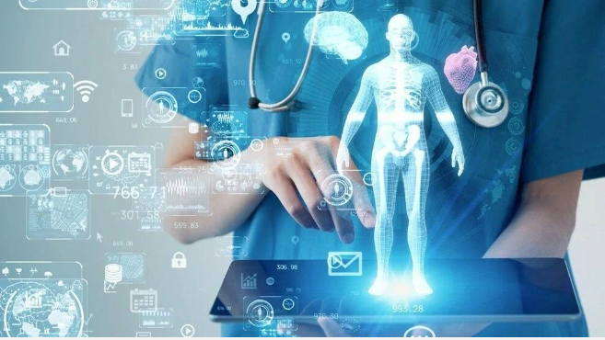
Future'X

Slide 2
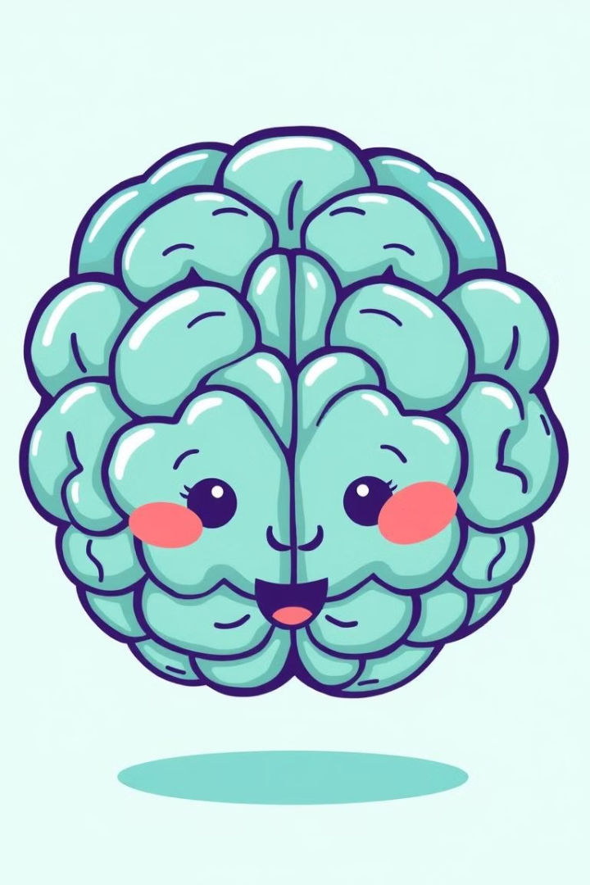
What is Deep Learning?
Description
Data Requirement
Deep learning is a sub-branch of machine learning. It uses multilayer artificial neural networks..
It requires large amounts of unstructured data. Image, text, audio and video data can be used.
Computational Power
Automation
It requires high processing power.
Used to automate complex tasks. Reduces human intervention.

Slide 3
Data sufficiency
Data Amount
Data Quality
Data Diversity
Large data sets are advantageous for deep learning.
Data must be clean and labeled. Incorrect data adversely affects the model.
A variety of data representing different scenarios is required.

Slide 4

About My Company (Future'X)
1
Company Goal
My company will develop a deep learning-based platform that works in the healthcare industry, specifically in the field of early detection and imaging analysis.
2
Method
By detecting diseases at early stages from medical images (X-ray, MRI, CT scans), we will support doctors in more accurate diagnosis and treatment processes.
3
Data Amount
Millions of X-rays, MRIs and other medical images are available, along with labeled data from patients. Sufficient clinical data is available.

Slide 5

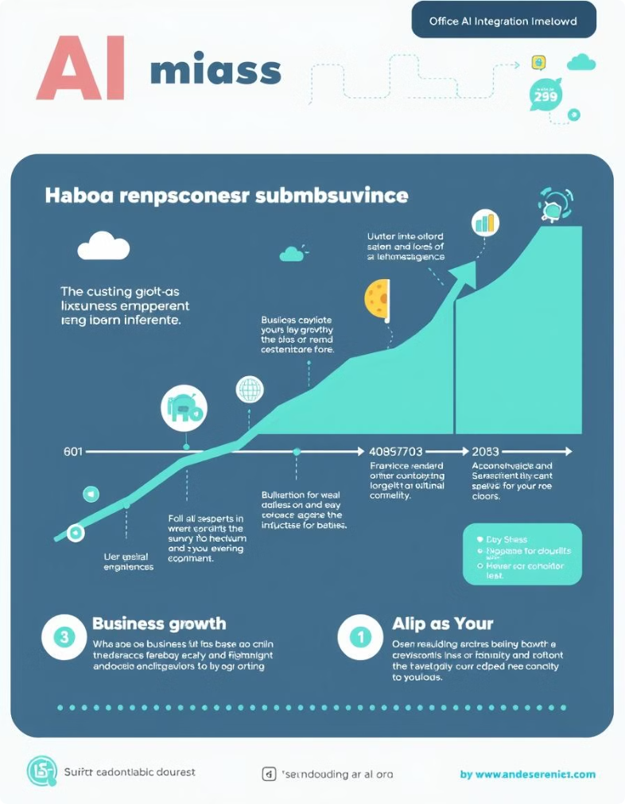



Justification of Findings
Method
There are explainable artificial intelligence (XAI) techniques developed to understand results with deep learning models.
Application
Doctors can better understand on the basis of which characteristics the model was decided.
Integration
Time efficiency can be achieved through integration with existing systems. Business processes may need to be redesigned. Number of employees may change.

Slide 6





Potential Benefits
Productivity Increase
Innovation
Cost Savings
Customer Experience
Time can be saved by automating routine tasks.
New products and services can be developed. Competitive advantage can be achieved.
In the long run, labor costs can be reduced.
Personalized services can be offered. Customer satisfaction can be increased.

